Slide 1
Category review: Chips
June 2020
Retail Analytics
Brand note: If client logo is not required, use alternate title page layout right click slide thumbnail > Layout > Title

Slide 2
Notes:
To view Privacy video explaining how important data privacy is to Quantium, please click here: https://www.youtube.com/watch?v=Zq1QDAkoRzU
or here Q:\Company Reference\Brand & Design\Brand videos\Q Privacy.mp4
At Quantium, we believe that data is the behavioural footprint of humanity and that it has to be treated with the utmost care and responsibility.
Histories, attitudes, indeed lives are stored within it in ways that aren’t always apparent – and that’s what makes its potential so powerful.
To work with it responsibly, sensitively, we set ourselves the highest data privacy protection and governance standards.
We have spent 17 years perfecting privacy-by-design and secure-by-design principles. Central to this is not holding any personally identifiable information about people –
we neither receive it, and put the necessary protections in place to be unable to decipher it.
Every aspect of handling data is safeguarded: from its de-identification, to its encryption – data security is paramount and of the highest grade.
We pride ourselves on gaining the trust of iconic organisations around the world through years of securely working with their data,
and in turn the trust that builds with their stakeholders.

Slide 3
Executive summary
01
Task 1
High Premium Spend: OLDER FAMILIES and OLDER SINGLES/COUPLES spend more on premium products.
Targeted Marketing: Promote premium products to older groups and budget-friendly options to younger ones.
Customer Loyalty: Create loyalty programs and customization for high spenders.
02
Task 2
Sales Performance: Store 77 saw stable sales; Store 86 experienced declines; Store 88 had sales growth with fluctuating customer behavior.
Purchase Encouragement: Implement discounts and loyalty rewards in stores with high foot traffic but low transaction frequency.
Performance Monitoring: Regularly track store performance and adjust strategies based on customer behavior and sales trends.

Slide 4
01
Category

Slide 5
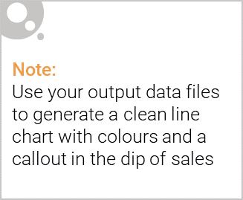
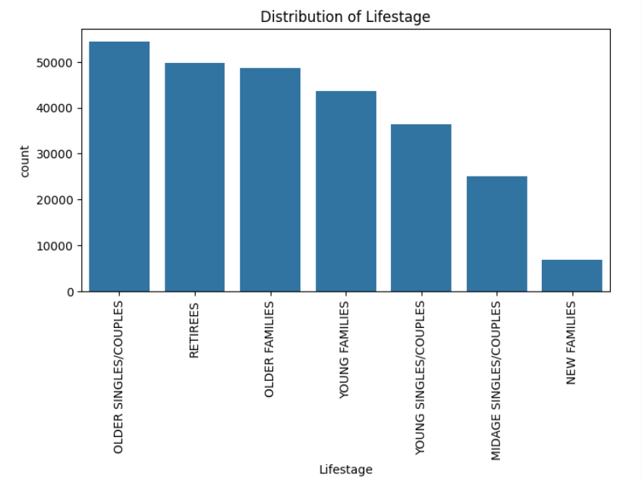
Singles/Couples and Young Families are the largest group. The population leans towards older ages, indicating a potential aging population.

Slide 6

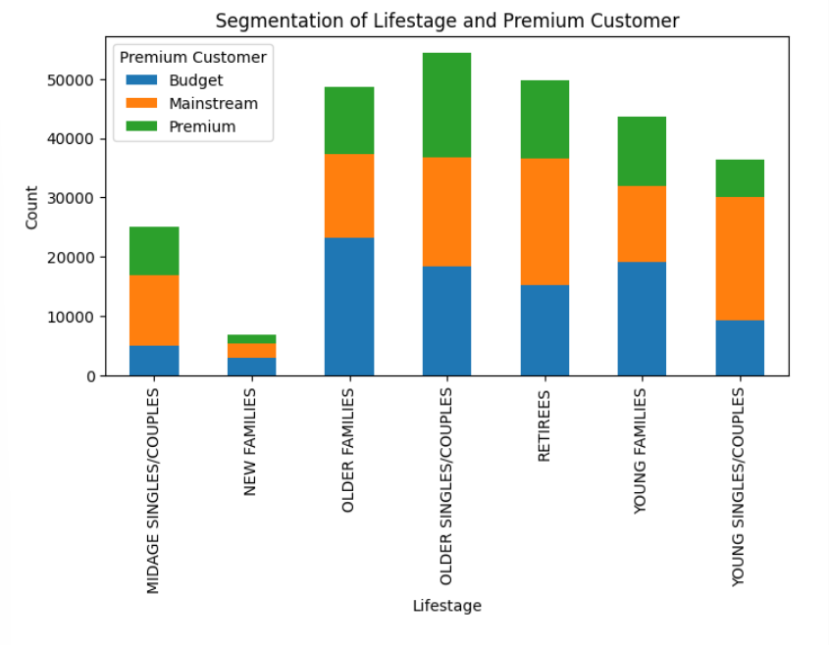
1. Spending Power: Older Families have the highest spending capacity, while New Families have the lowest.
2. Premium vs. Mainstream: Older Singles/Couples and Older Families favor premium products, while Retirees lean towards mainstream options despite their budget.
3. Premium Spending Tendencies: Older Families and Older Singles/Couples are most likely to spend on premium products, while Younger demographics are more budget-conscious.

Slide 7
Strategies
Tailored Marketing: Target older demographics with premium product benefits and younger demographics with value propositions.
Product Alignment: Offer value-oriented products for Retirees and affordable options for New Families.
Strategic Pricing: Prioritize premium products for high-spending older demographics and introduce budget-friendly premium options for younger segments.
Customer Retention: Implement loyalty programs for high-spending customers and enhance engagement through product customization.

Slide 8
02
Trial store performance

Slide 9
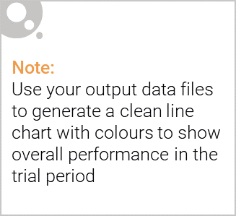
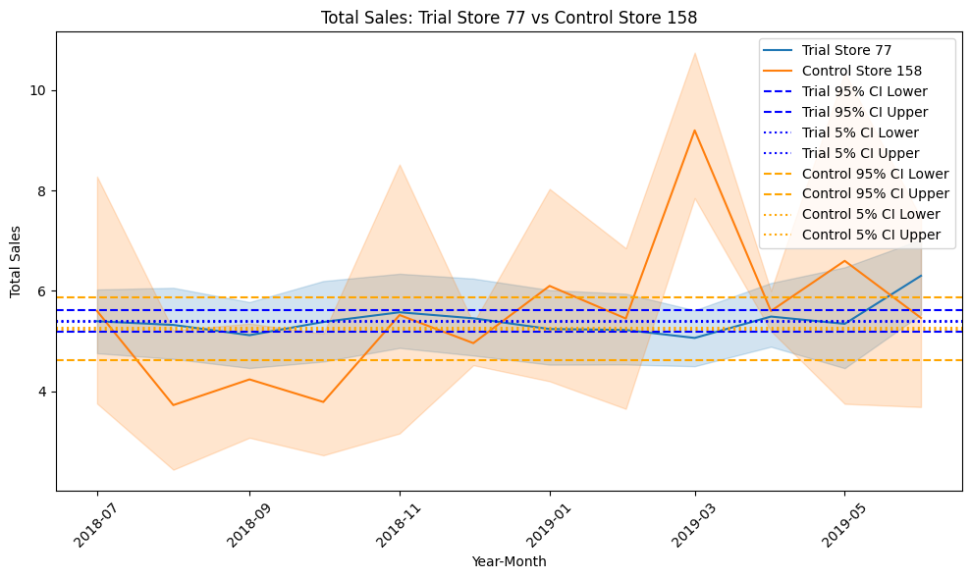
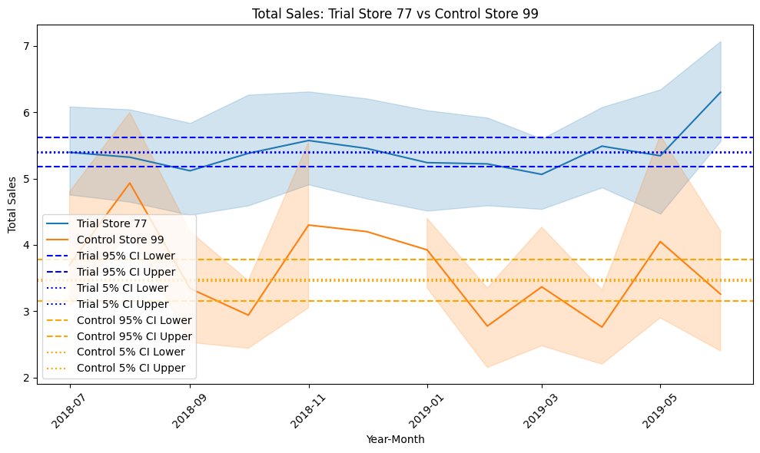
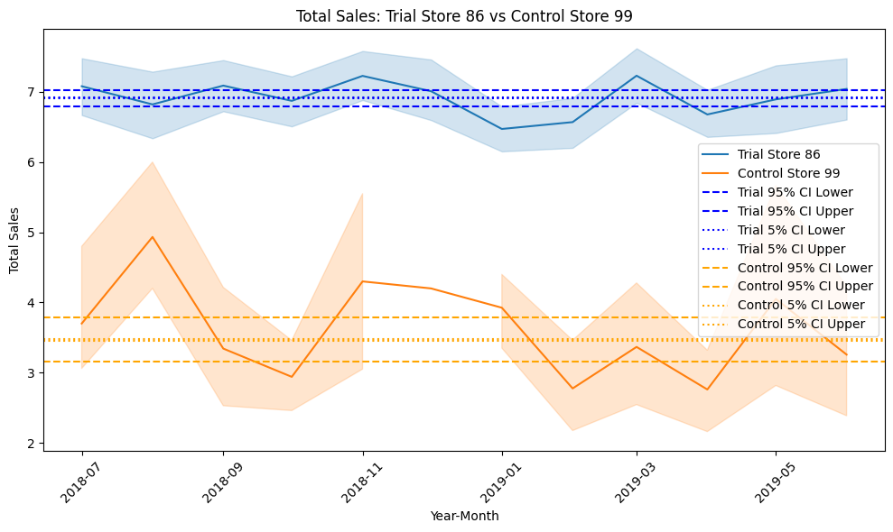
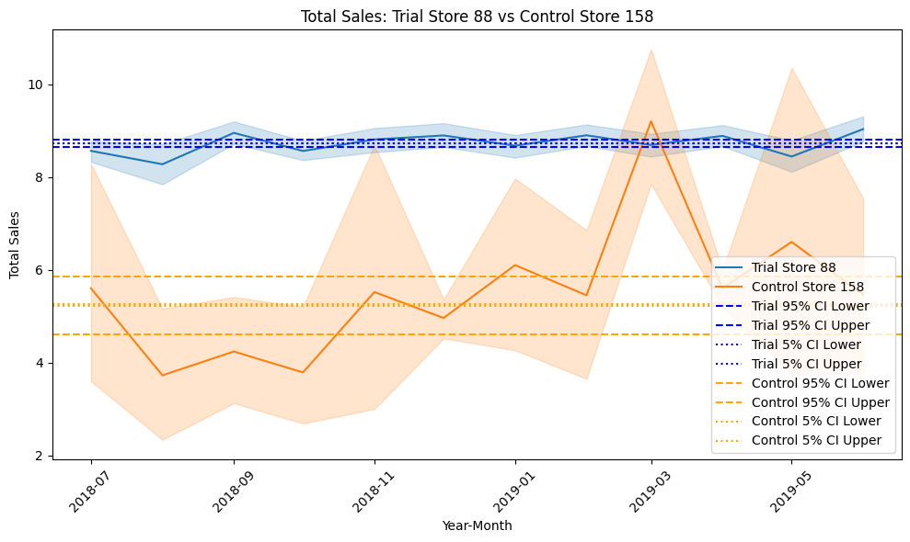

Slide 10
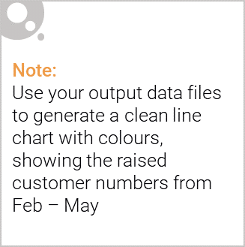
Insights
Store 77: Stable performance, increased sales compared to certain stores.
Store 86: Sales decline due to decreased customer traffic and purchase frequency.
Store 88: Sales increased but customer behavior inconsistent.
Recommendations
Boost Sales: Encourage repeat purchases through promotions and rewards.
Performance Tracking: Monitor store performance and adapt strategies accordingly.
Customer Retention: Focus on retaining new customers with personalized offers.

